Slide 1

Under the supervision of
Dr.Rajkumari Bidyalakshmi
ONLINE MarketPlace
BY AKSHAT KUMAR
CSE
21010113

Slide 2
Introduction
Objective
Existing Method
Use case Diagram
Activity Diagram
Solution
Conclusion

Slide 3
introduction
what is e-commerce marketplace?
what actors are involved in it?
brief on existing system?
what technology have been used?

Slide 4
Objective
Developing a multi-platform e-commerce website that seamlessly facilitates both buying and selling activities poses a complex challenge.
The system must efficiently manage user interactions, secure financial transactions, and provide a user-friendly experience for individuals engaging in diverse roles as buyers and sellers.

Slide 5
Existing System
Amazon is an online retail platform where users can buy a wide range of products, and third-party sellers can list and sell their items, facilitated by secure payment transactions and extensive logistics support.
OLX is a platform where users can buy and sell used goods locally, connecting buyers and sellers directly, often through a simple ad posting system without an intermediary payment process.

Slide 6
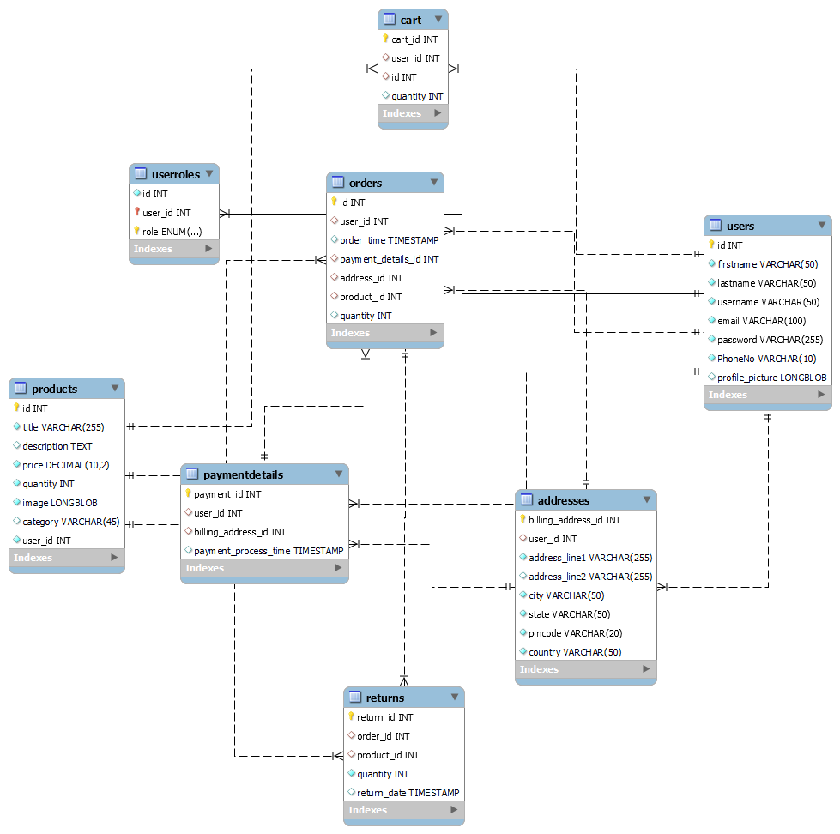
Class Diagram

Slide 7
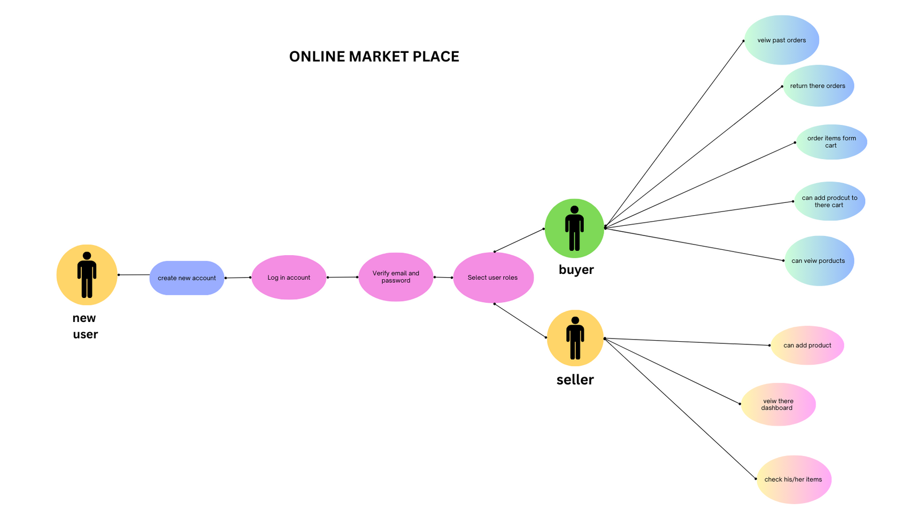
Use Diagram

Slide 8
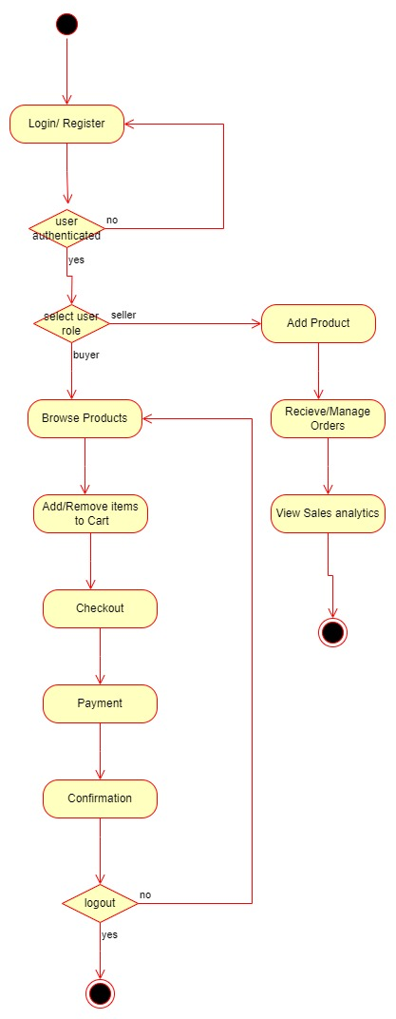
Activity Diagram

Slide 9
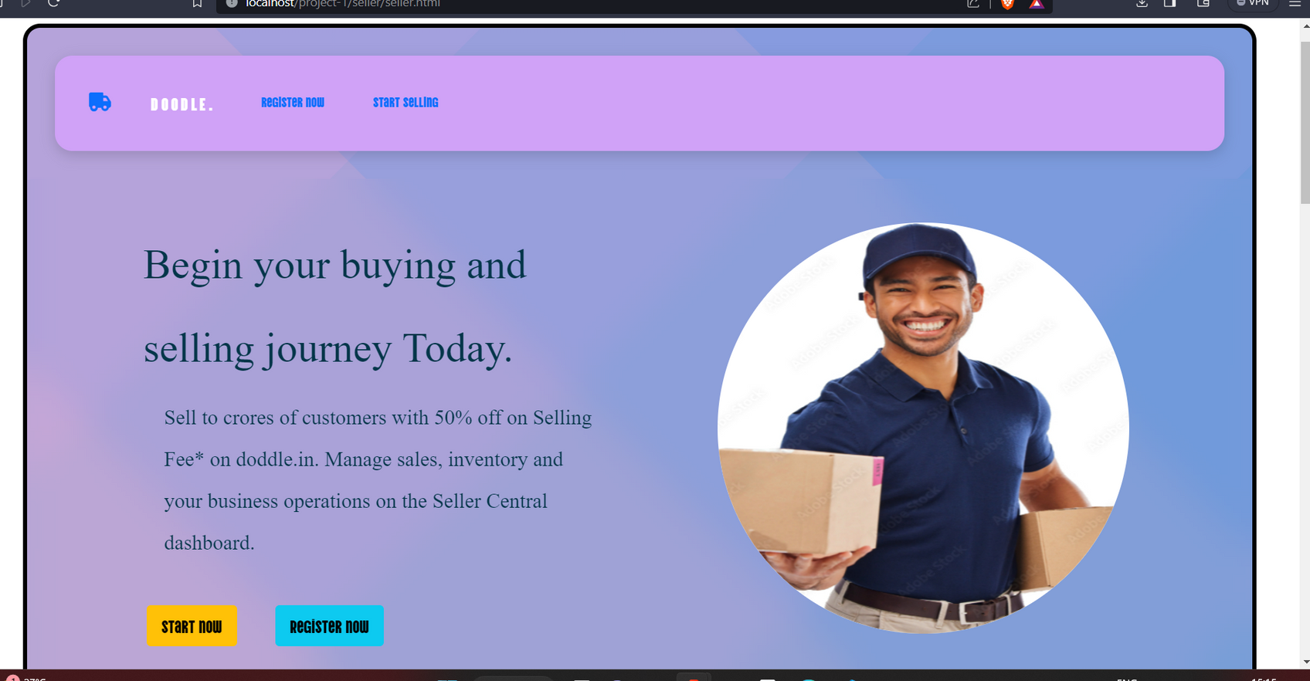
website

Slide 10
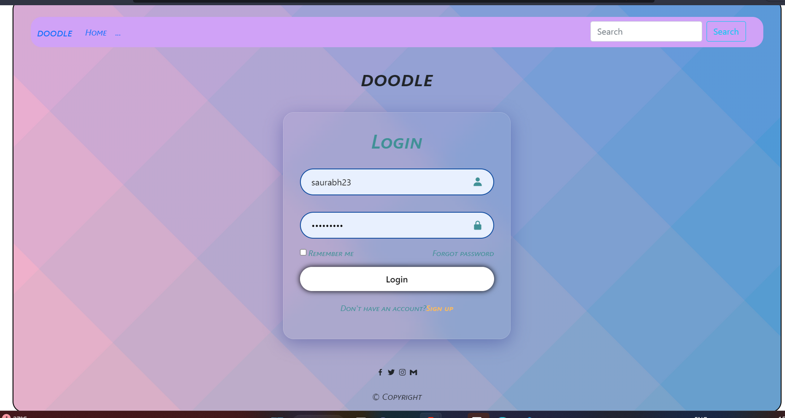
website

Slide 11
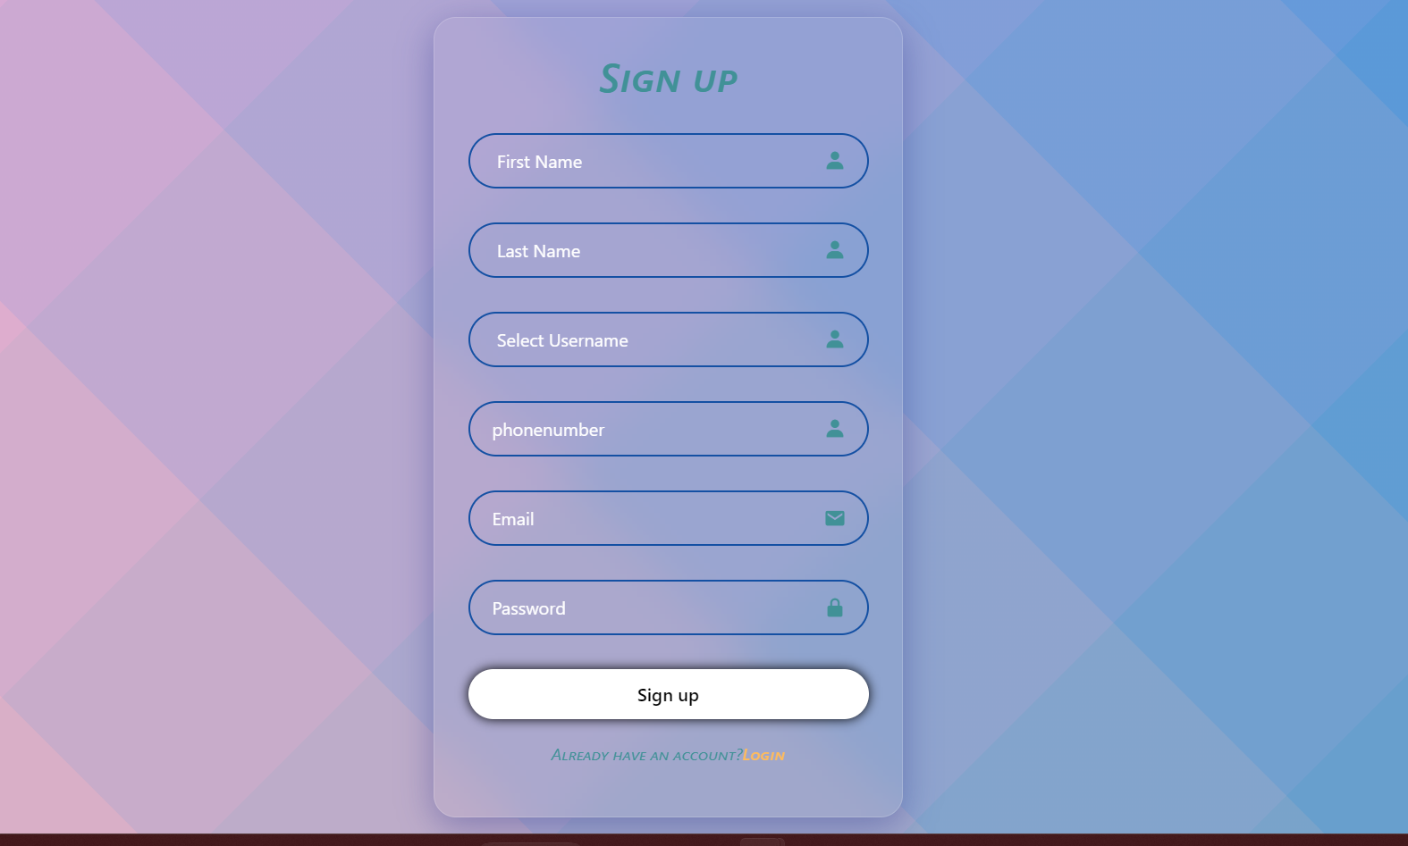
website

Slide 12
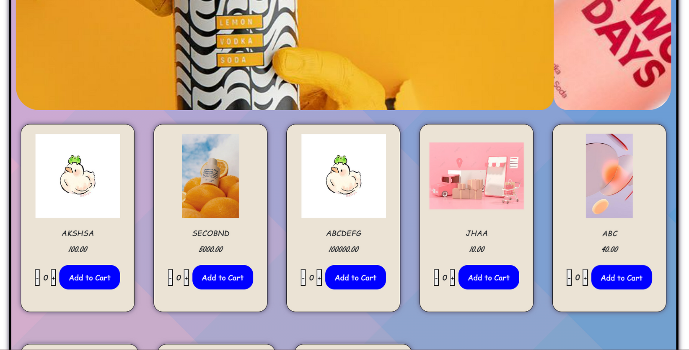
website

Slide 13
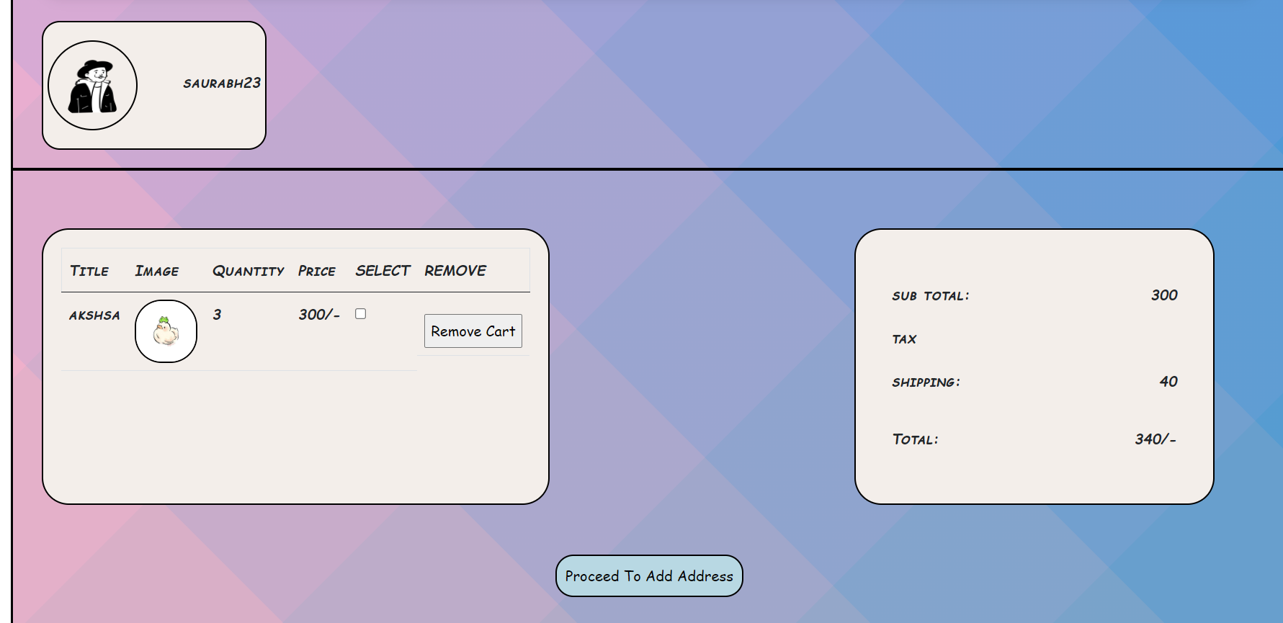
website

Slide 14
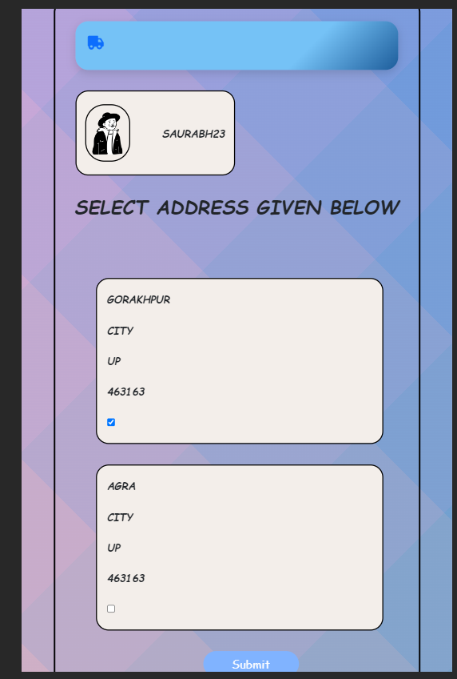
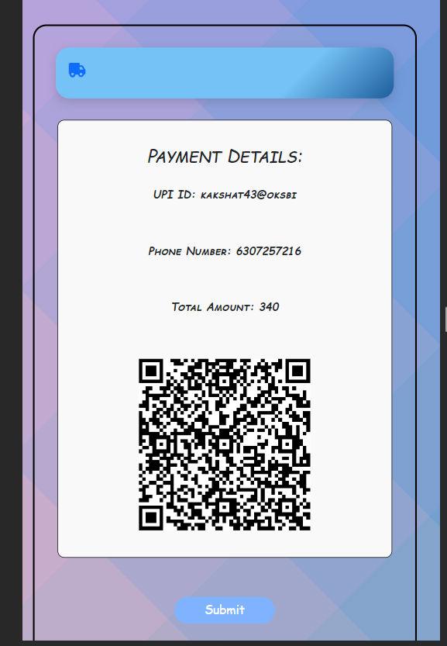
website

Slide 15
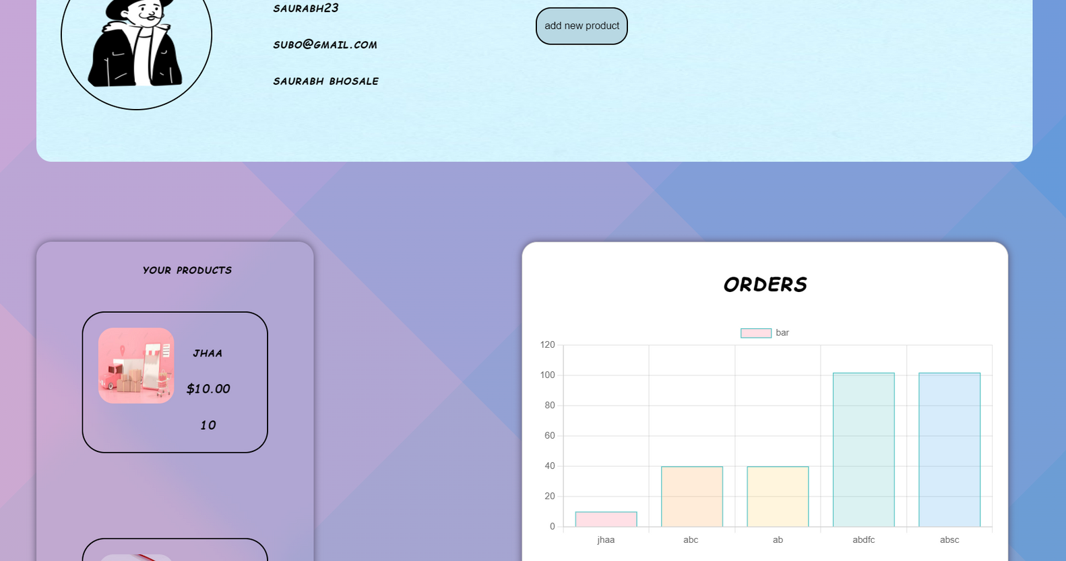
website

Slide 16
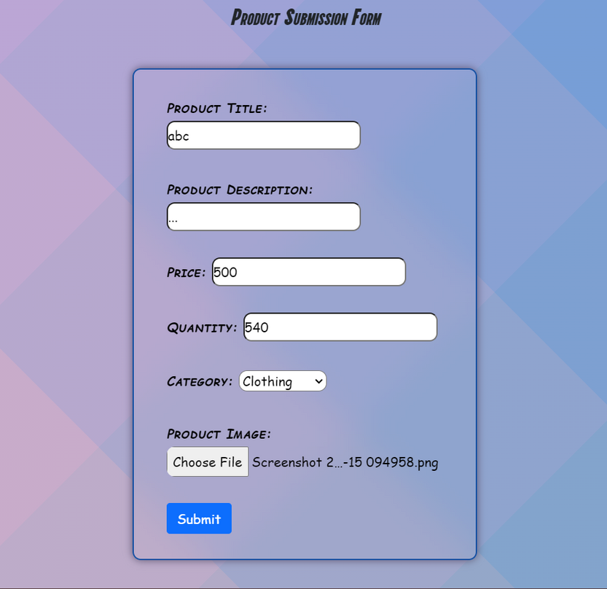
website

Slide 17
Solution
Unified E-commerce Platform
Seller Dashboard
User Management
Quick Payment Method

Slide 18
Conclusion
it is convenient they don't need separate accounts.
It makes the site easy to use and can attract more people.
The setup also encourages users to stay longer and discover new things

